Slide 1
NFC based Game: ROCK PAPER SCISSORS
Juilee Chitre
Meghambari Khavnekar
Niharika Maheshwari
Saylee Chitre
Vidhya Suresh

Slide 2
OVERVIEW
Recap
Technologies Used
Milestones
Planned Tasks
Demo

Slide 3
RECAP
Near Field Communication
Steps involved
Reading from NFC tag
Beaming
Interaction with Database
Updating the Database
Our Prototype – Rock Paper Scissors
Alternate Reality Game - Elder Scrolls

Slide 4
Traditional Rock, Paper, Scissors
Elder Scrolls Online: Warrior, Thief, Wizard

Slide 5
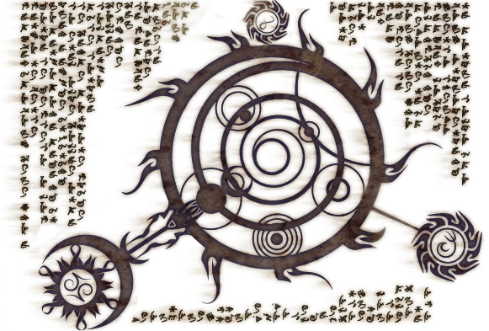






Game Piece

Slide 6
Technologies Used
NFC tag – Gema Touch NFC Proprietary technology
Database – MySQL
Server – XAMPP
Server-side scripting - PHP

Slide 7
MILESTONES
Writing and Reading from an NFC tag
Server-side scripting
Beaming
Game logic
Displaying statistics of the game to user
Viewing result on mobile device
Additional Functionality (Rock, paper, scissors, lizard and spock version)

Slide 8
PLANNED TASKS
Improving the UI
Randomizing the positions of rock, paper, scissor buttons
Authentication of the user
Avatar selection by user in NFC mode

Slide 9
DEMO

Slide 10
Questions?
-THANK YOU

